Slide 1
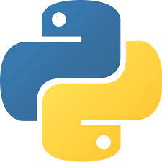
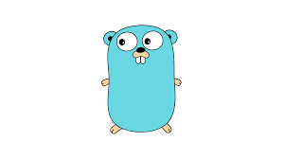
PYTHON AND GOLANG
BY:
NAME:CH.V.PAVAN KALYAN
EMP-ID:46075920
BATCH:BI-MS AZURE.

Slide 2
INDEX
Python
Go-Lang
Comparison
Pandas Data Structures
Reference
Conclusion

Slide 3

Python
Guido van Rossum
Developed in 1991.

Slide 4

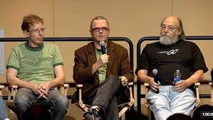
GO-LANG
Robert Griesemer
Rob Pike
Ken Thompson
Developed in 2007.

Slide 5
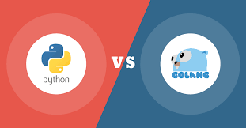
COMPARISON
Performance
Scalability
Application
Execution
Libraries
Readability of code

Slide 6
PANDAS DATA STRUCTURES
Series
Data Frame
Panel

Slide 7
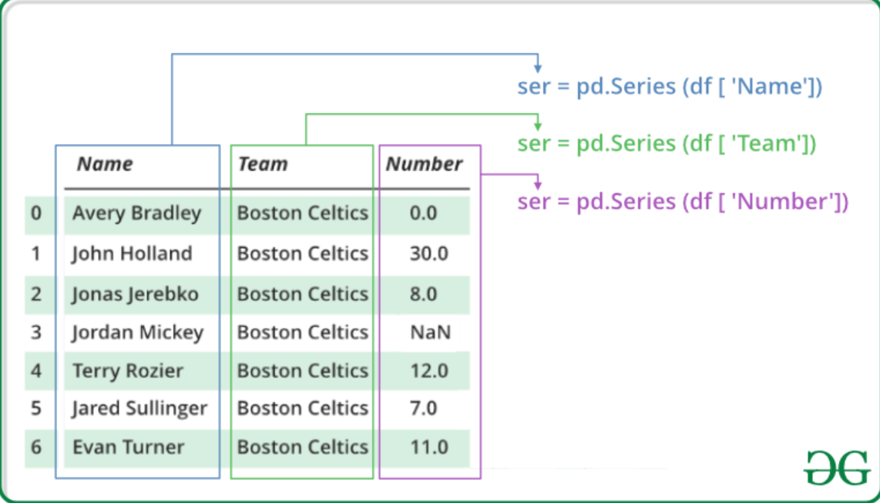
SERIES:
One Dimensional Array.
Data types like int, str, float, python objects etc…
Excel sheet

Slide 8
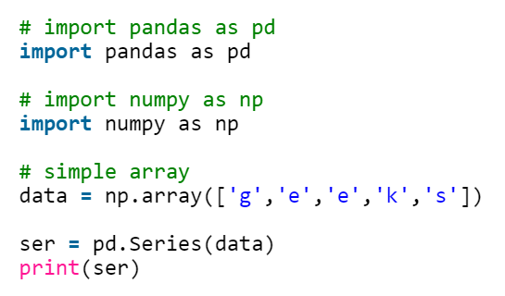
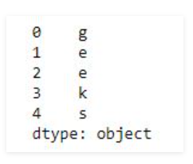
Creating Series:
Output:

Slide 9
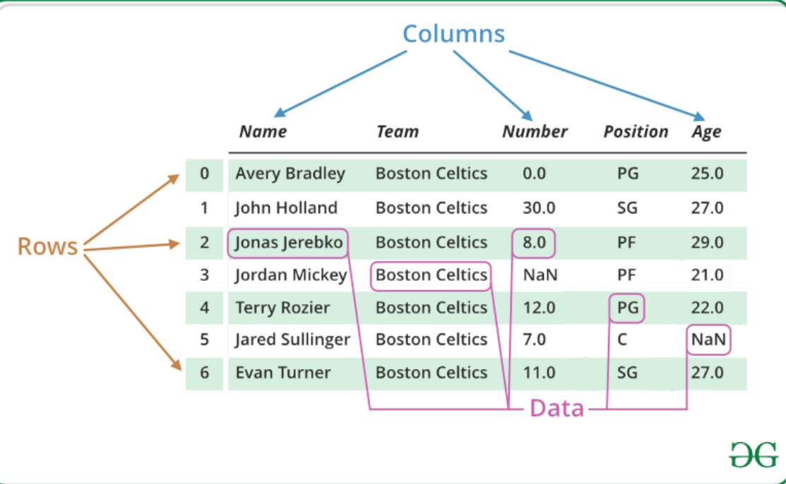
DATA FRAME:
Two Dimensional Array.
Tabular form.

Slide 10
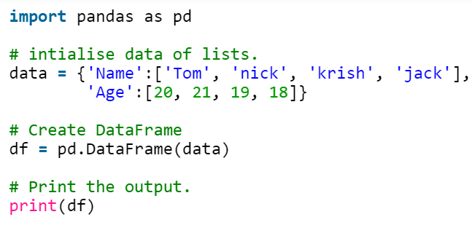
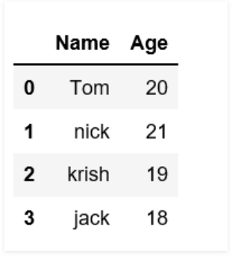
Creating Data Frame:
Output:

Slide 11
PANEL:
Three Dimensional Array.
3 Axes.
i)Item
ii)Major_axis
iii)Minor_axis

Slide 12
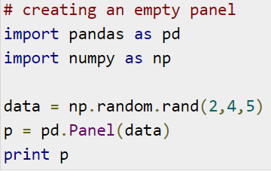
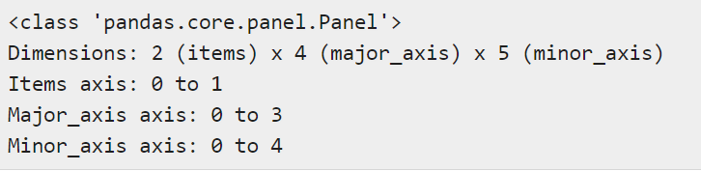
Creation of Panel:
Output:

Slide 13
REFERENCES
https://www.softkraft.co/golang-vs-python/
https://dzone.com/articles/golang-vs-python-which-one-to-choose
https://www.geeksforgeeks.org/python-pandas-dataframe/
https://www.geeksforgeeks.org/python-pandas-series/

Slide 14
CONCLUSION
Go-Lang is faster than python.
It is fastest growing technology.
Both languages are simple to learn.
Pandas are used for Analysis, visualization purpose.
Data Frame is used all over now a days.

Slide 15


